Slide 1
Project 4
Predicting Stock price
By alex lu
September 2019

Slide 2
Problem
Predicting today’s stock price based on past 7 days open, close, low, high and volume data.
As an example, we use apple stock in our modeling. We will predict apple stock’s closing price based on past 7 days’ open, close, low, high and volume data.

Slide 3
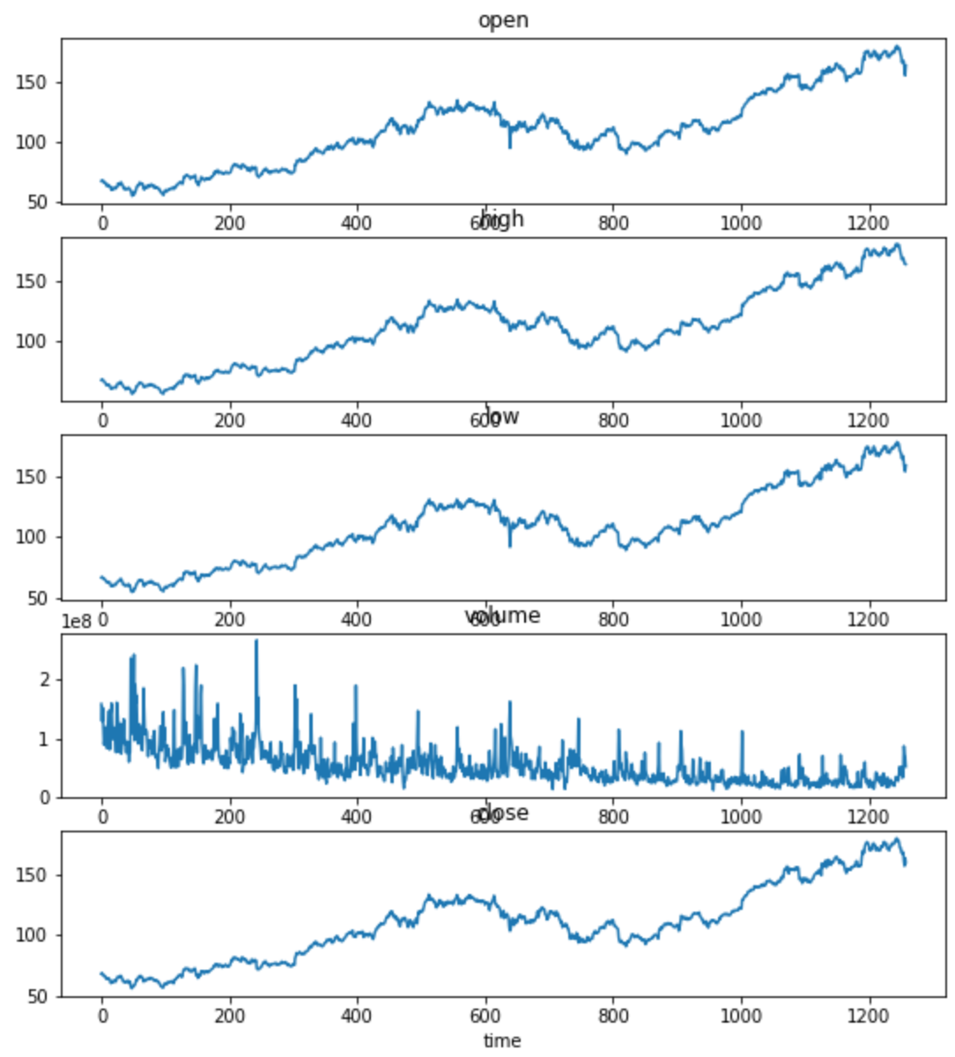
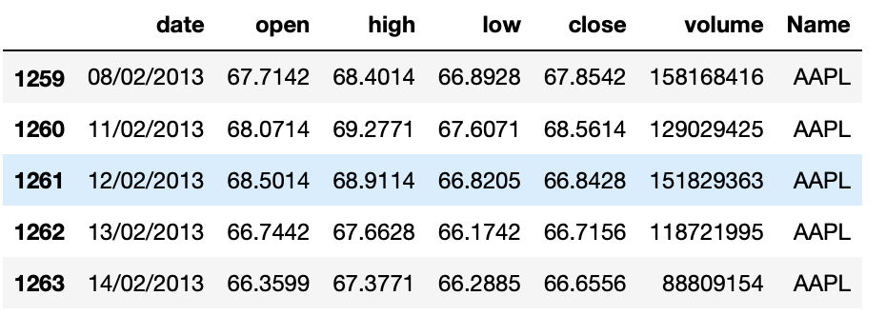
Data
Raw Data: source Kaggle. Very clean. First glance makes sense.

Slide 4
Solution
Intuition: a technical trader often takes consideration of previous days trading momentum when making a decision to buy or sell on any given day. These momentum are reflected in past historic price action: What were the volume in the stock? Was it making higher highs or lower lows? Was closed at bottom of the daily range or top?
Long Short Term Memory (LSTM) model: LSTM is type of RNN neutral network model that solves long time lag, and it is often used for time series problems like the one we are working on.

Slide 5
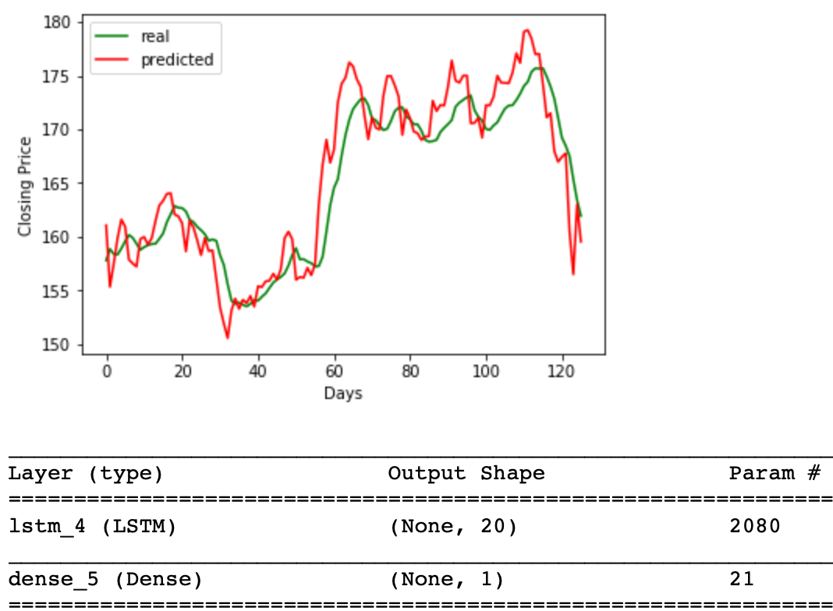
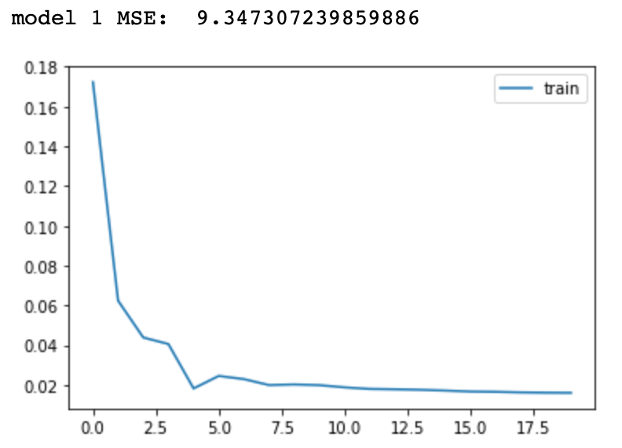
Results
Compare different models based on Mean Squared Error (MSE) measure, the simple model with one LSTM layer and one dense layer became the winner with MSE of 9.3. When comparing predicted closing price vs actual in the testing data, graphically, they tracks very well. However, there is a tendency of undervaluation in a bull market, and overvaluation in a sell off market.

Slide 6
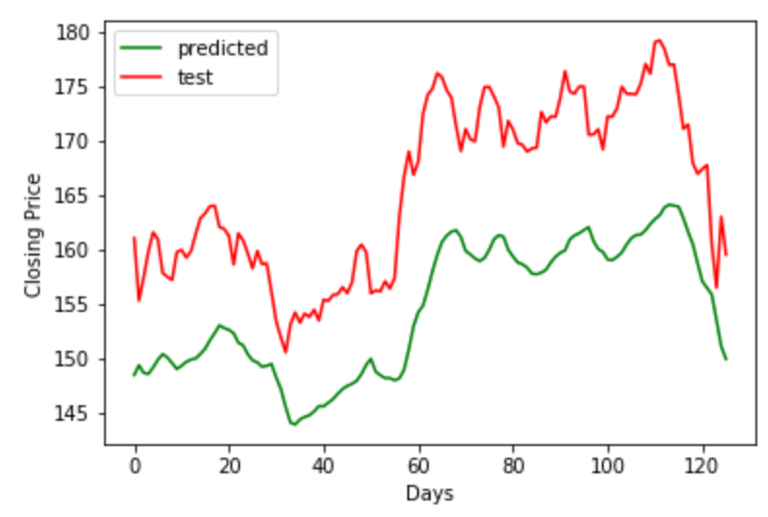
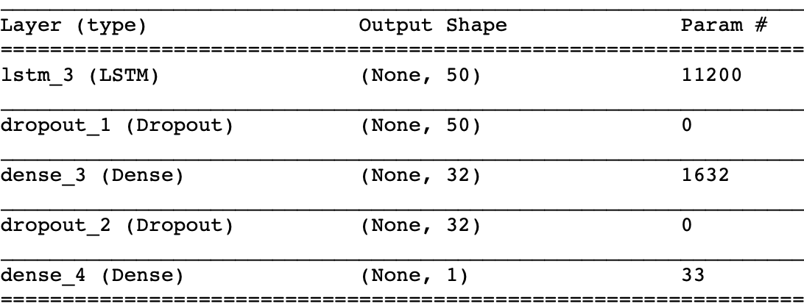
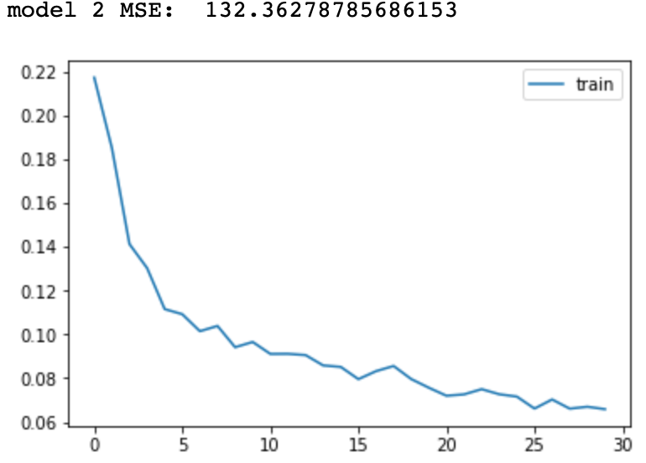
Results with other parameters
Model 2:
1x Lstm 50 nodes
1x Dense layer with relu activation
1x Dense layer with linear activation
Result: Terrible. The model seems to have a downward bias.

Slide 7
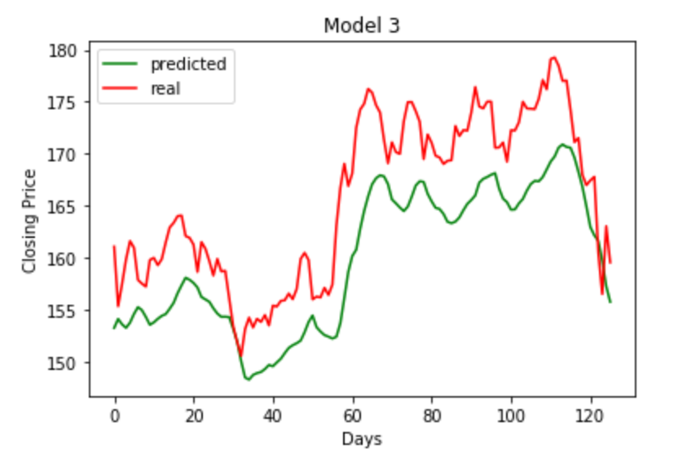
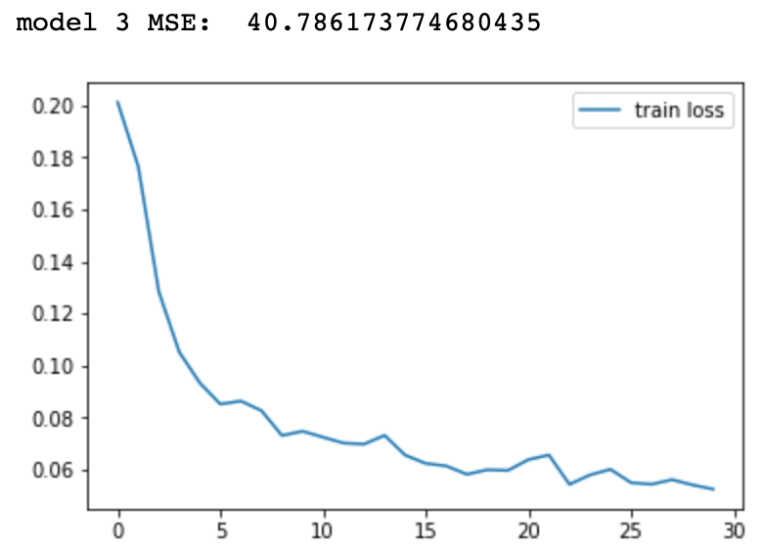
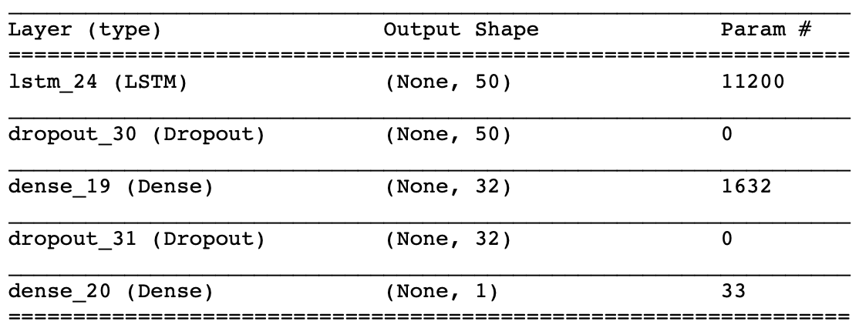
Results with other parameters
Model 3:
Same as Model 2 except activation linear
Result:
Better than model 2. Suggesting that linear activation in more appropriate than relu in this case.

Slide 8
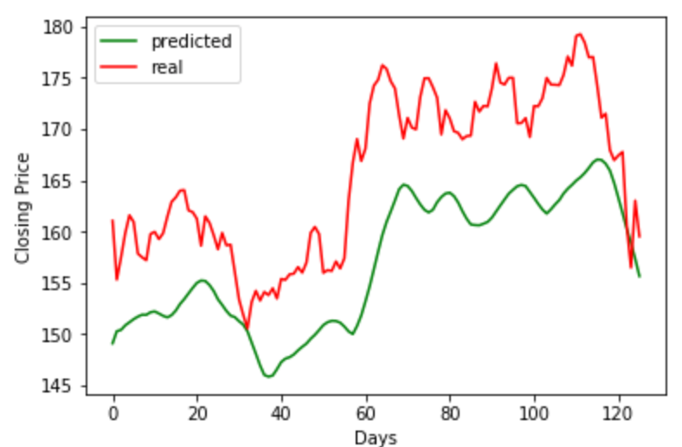
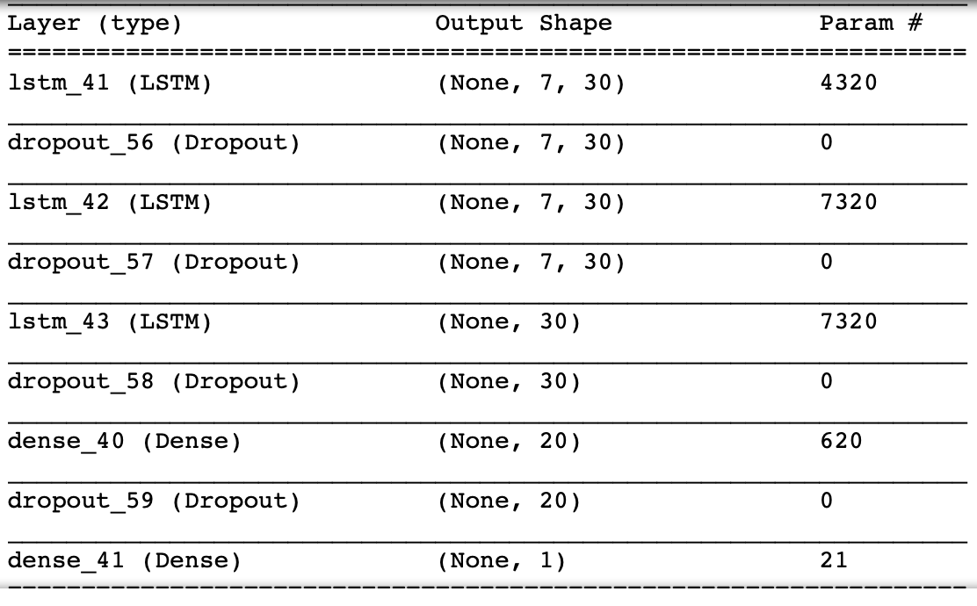
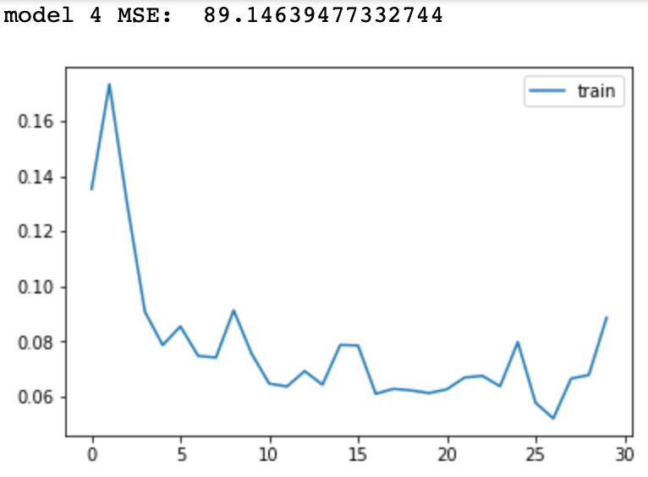
Results with other parameters
Model 4:
3x Lstm (testing with different node size 30, 40, 50)
2x Dense layer with linear activation
Result: the model with lower number of nodes seem to perform better on average with lower MSE ranging from 20 to 200. However, they are all worse than Model 1.

Slide 9
Conclusion
A simple LSTM model worked well in our case.
Complexity does not always improve modeling.
Business implication:
The model is a good guidance in a normal market trading environment.
However, the model is not suitable for prediction in unprecedented major event, such as 9/11 or financial crisis 2007.
When trading with this model, stop loss trigger should be implemented.

